Slide 1


Laravel 11
Setup Laravel

Slide 2
Buat file Laravel
>> laravel new NamaProjek
>> composer create-project laravel/laravel NamaProjek

Slide 3
Konfigurasi .env
DB_CONNECTION=mysql
DB_HOST=127.0.0.1
DB_PORT=3306
DB_DATABASE=nama_database
DB_USERNAME=root
DB_PASSWORD=password

Slide 4
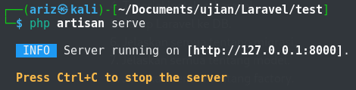
Test Koneksi
>> php artisan serve

Slide 5
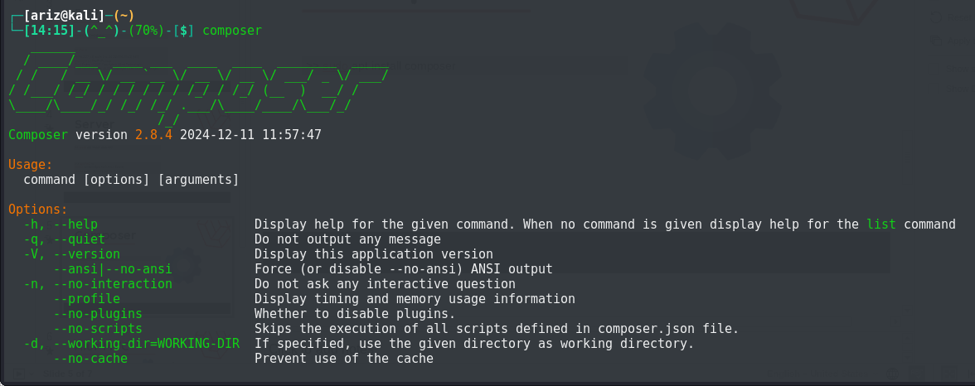
Composer
>> sudo apt install composer

Slide 6
Laravel 11
Migrasi

